Slide 1
US Decision Science
Addressing Collinearity in Promotion Mix Models
Method of using pseudo-predictors
Jan 2007

Slide 2
Objective
Review two approaches used by PM&T group to deal with collinearity in promotion mix models
Two approaches are reviewed
  Residual approach – This in some form was used in the past to address collinearity between details and samples
  SVD approach – This was tried when incorporating PIL (Polynomial inverse distributed lag) in the models introduced a much higher degree of collinearity between lagged variables

Slide 3
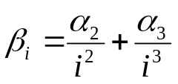
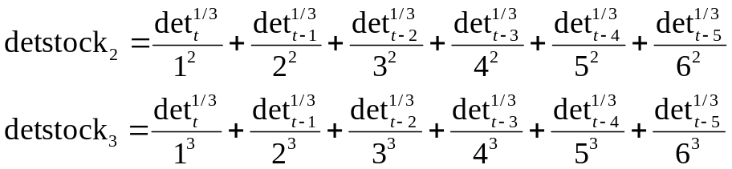
Brief intro to PIL structure
Goal: Estimate the lagged effect of interventions in a particular month
Method: Estimated by employing lagged predictor variables in the mix model
PIL refers to the structure imposed on the lagged coefficients
They are constrained to lie on the following polynomial
Allows a more flexible decay structure
The goal now becomes estimating alpha using the following stocked predictor variables
These two variables are highly collinear (>90%)!!
This was the motivation for exploring SVD method
However, the residual method might actually be more accurate (was a recent realization!)

Slide 4


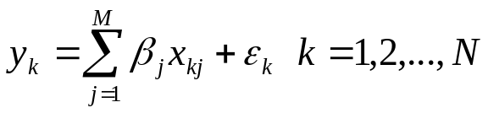

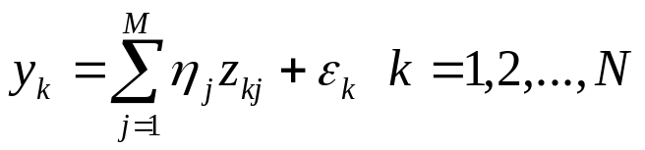
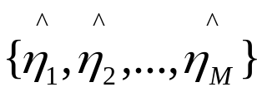
Basic Idea of the Approaches¹
0
Standardize the predictor variables to have mean 0 and variance 1
Consider a OLS model with M predictors and N observations:
Where the predictors exhibit a high degree of multicollinearity
Replace original predictors with new predictors (pseudo-predictors) that are uncorrelated
Assess the impact of pseudo-predictors on the dependent variable by running the following regression:
Suppose the estimates from this regression are given by:
1
2
Original predictors (correlated)
Pseduo predictors (un-correlated)
3
Reference:
1. Krishnamurthy. L. and Rangaswamy. A., The Equity Estimator for Market Research, Marketing Science, Vol 6., 1987, p336

Slide 5
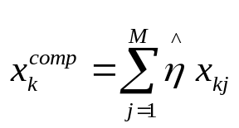


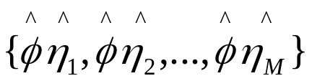
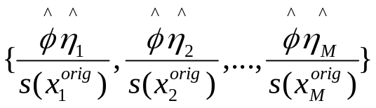
Basic Idea of the Approach (contd)
4
Assume that the relative impact of the original predictors is the same as the relative impact of the psuedo-predictors
Create a composite predictor variable based on this assumption
Estimate the impact of the composite variable on the dependent variable (This step can also be viewed as calibrating the dependent variable in terms of the original predictor variables)
Suppose the estimate is given by
The impact of standardized x variables on the dependent y variable is given by:
The impact of original x variables on the dependent y variable is given by dividing by the standard deviation of the original variables:
5
6
7

Slide 6
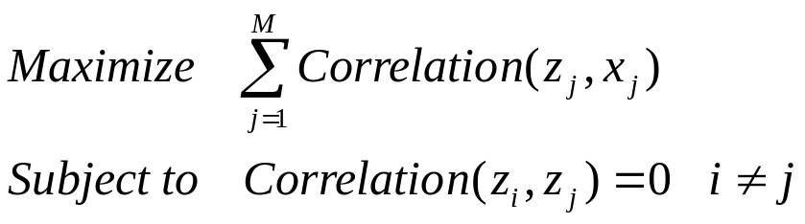
Psuedo-Predictors construction (SVD Method¹)
Basic idea of the method:
Create a set of uncorrelated variables that are as close as possible (in terms of correlation) to the original variables
Geometrical interpretation:
z₁
x₁
x₁
x₂
x₂
z₂
Reference:
1. Krishnamurthy. L. and Rangaswamy. A., The Equity Estimator for Market Research, Marketing Science, Vol 6., 1987, p336

Slide 7
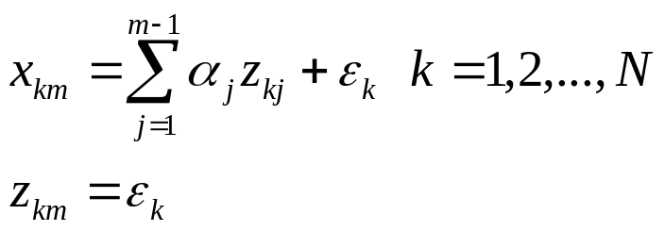
Psuedo-Predictors construction (Residual method)
Basic idea of the method:
Keep only the unique variation of the predictor variable that is not explained by other predictor variables
Psuedo-variable {z_{m}} is determined as the residual from regressing {x_{m}} on {z₁,z₂…z_{m-1}}
Geometrical interpretation:
x₁
z₁=x₁
z₂
x₂
x₂

Slide 8
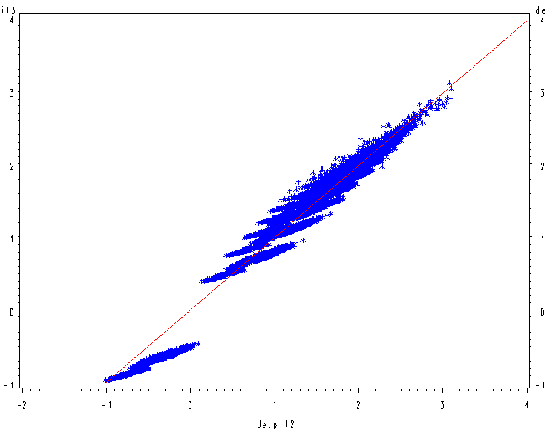
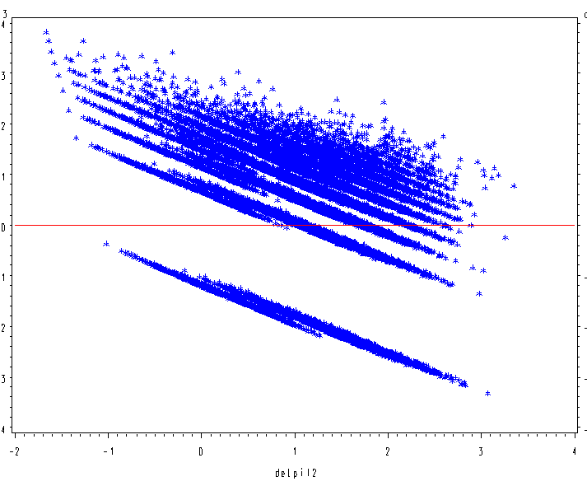

Example 1: (SVD method with detail PIL stocks)
Scatter plot of original predictors
Scatter plot of pseudo predictors
Detstock2 (x2) vs detstock1 (x1)
z2 vs z1
Correlations

Slide 9
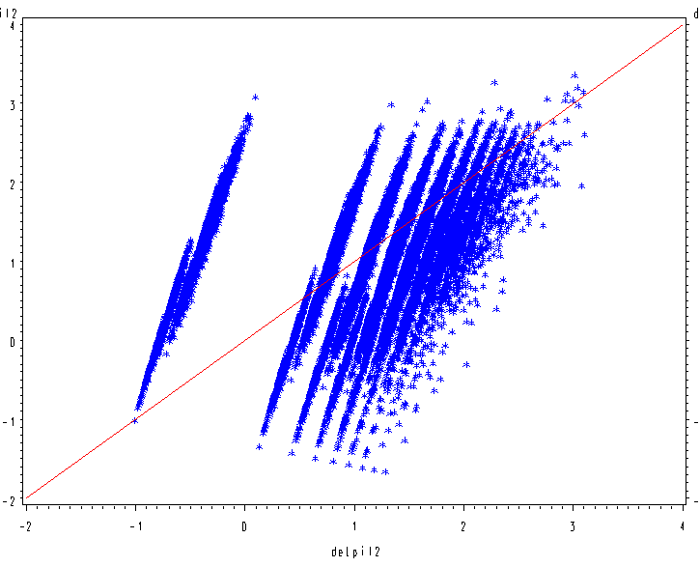
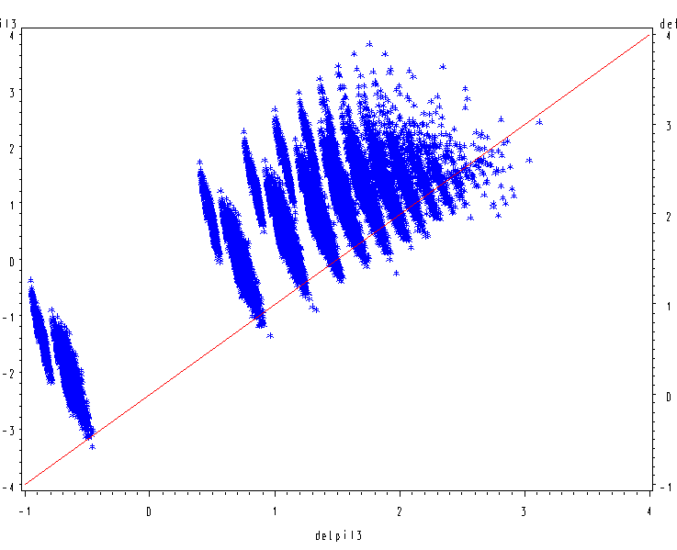
Example 1: (SVD method with detail PIL stocks)-contd
Comparison of pseudo predictors with original predictors
z1 vs detstock1 (x1)
z2 vs detstock2 (x2)

Slide 10
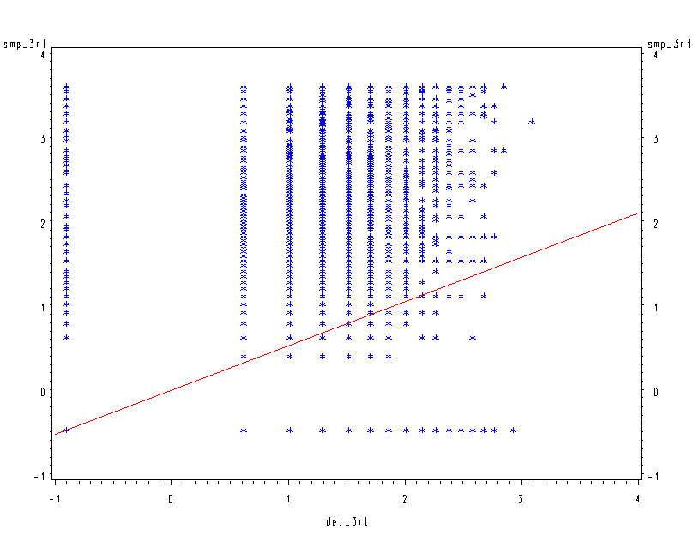
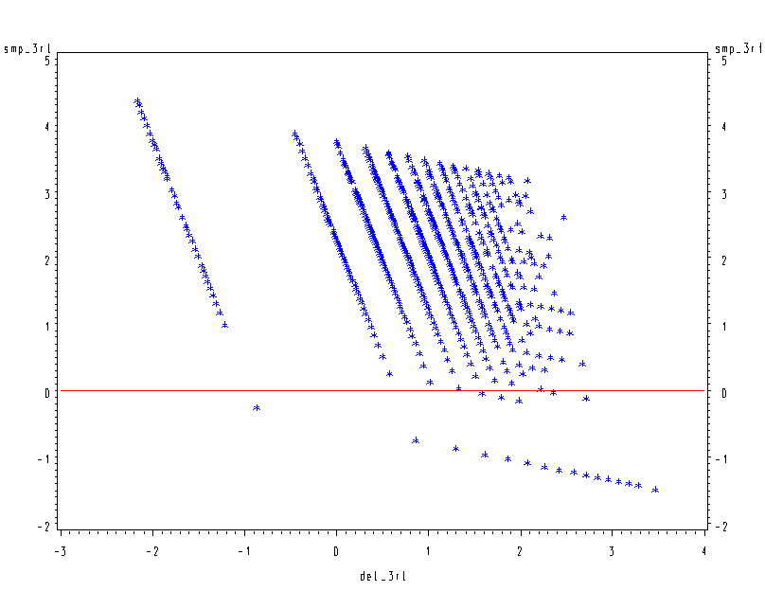

Example 2: (SVD method with details/samples)
Scatter plot of original predictors
Scatter plot of pseudo predictors
Smp_3rt (x2) vs det_3rt (x1)
z2 vs z1
Correlations

Slide 11
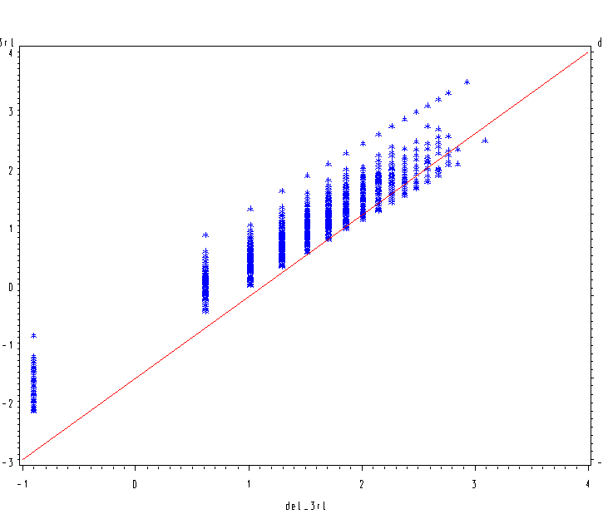
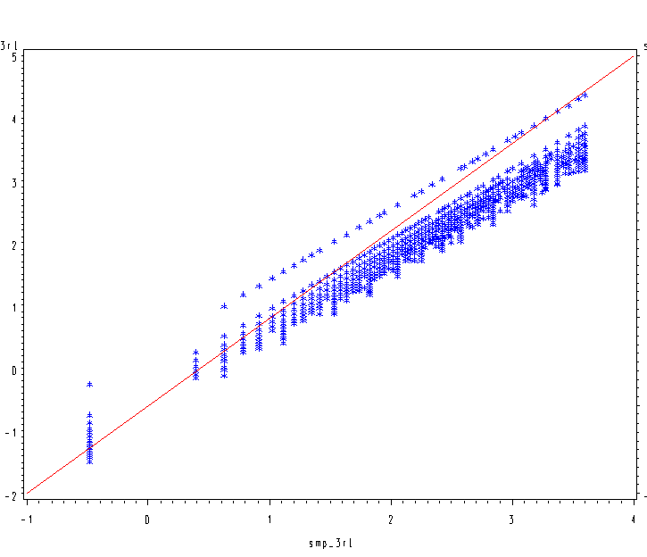
Example 2: (SVD method with details/samples)-contd
Comparison of pseudo predictors with original predictors
z1 vs det_3rt (x1)
z2 vs smp_3rt (x2)
z1 inflates lower values of det_3rt
z2 deflates higher values of smp_3rt

Slide 12
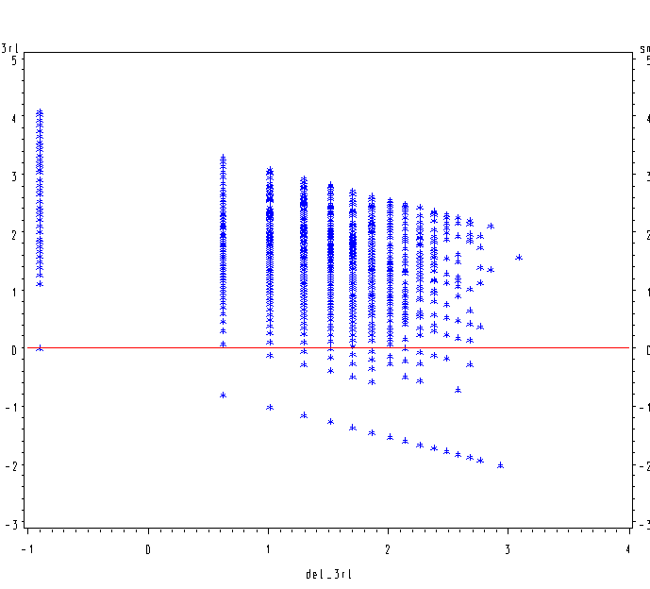

Example 3 (Residual method with details/samples)
Scatter plot of original predictors
Scatter plot of pseudo predictors
Smp_3rt (x2) vs det_3rt (x1)
Smpres_3rt (z2) vs det_3rt (z1)
Correlations

Slide 13
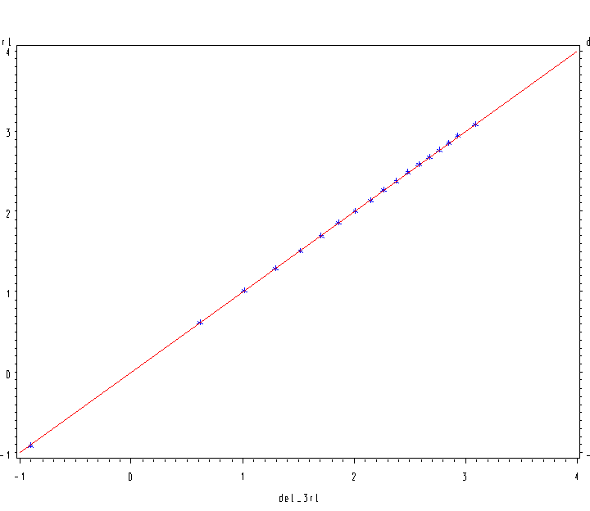
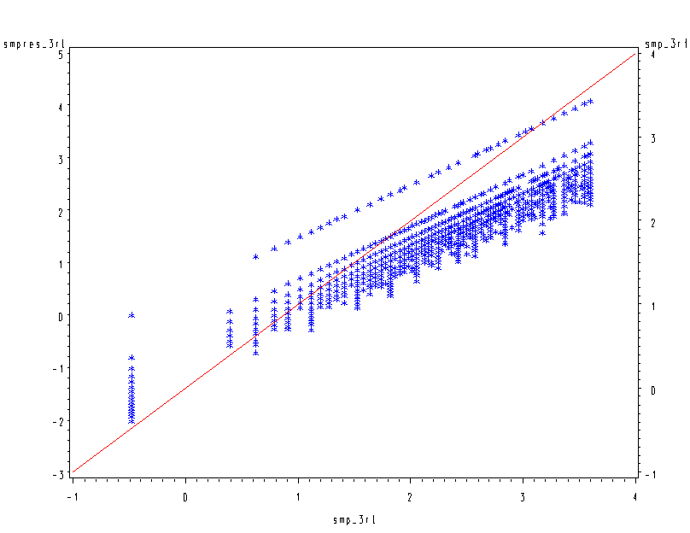
Example 3 (Residual method with details/samples)-contd
Comparison of pseudo predictors with original predictors
det_3rt (z1) vs det_3rt (x1)
Smpres_3rt (z2) vs smp_3rt (x2)
z2 deflates higher values of smp_3rt and inflates lower values of smp_3rt

Slide 14
Caveats of the approach
Assumption/Judgment driven construction of pseudo-predictors
Hard to estimate standard error and covariance of parameter estimates
Indicator variables might be difficult to handle with this approach
Approach more suited to response models created separately for each group (using by statements)

Slide 15
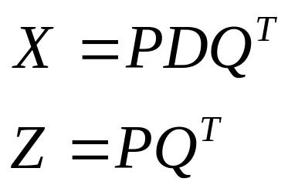
SAS code/Technical details of creating pseudo-predictors – SVD Method
SAS Macro
%getvar_by(inds=tempin,outds=tempout,byvar=segment,pcvar=%str(det smp prog)) ;
* inds - Input dataset ;
* outds - Output dataset ;
* byvar - By group variables ;
* pcvar - Variables for which Z matrix needs to be created ;
* z variables are stored under the name of pcvar2 ;
Technical Details of constructing Z variables
Singular value decomposition (SVD) of X
Reference:
1. Krishnamurthy. L. and Rangaswamy. A., The Equity Estimator for Market Research, Marketing Science, Vol 6., 1987, p336

Slide 16
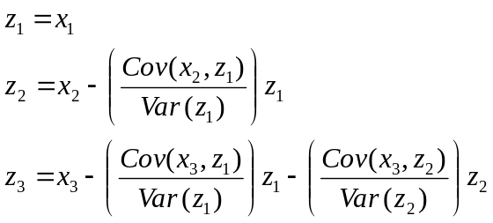

SAS code/Technical details of creating pseudo-predictors – Residual Method
SAS Macro
%getgsvar_by(inds=tmpinput,outds=tmpoutput,seg=dummy,xvar=%str(det smp prog)) ;
* inds - Input data set ;
* outds - Output data set ;
* seg - Segment variable (always needed) ;
* xvar - List of X variables that need to be made uncorrelated
This needs to be specified within the %str function - see example ;
* The output variables have the same name as input variables prefixed with res ;
Technical Details of constructing Z variables
…

